Slide 1


Slide 2







Team
Edson Rocha
Guilherme Quadros
Ândrei Schuch
Gabriel Fonseca
Pablo Parada

Slide 3
A cartoonish multiplayer zombie beat’ em up.

Slide 4
A cartoonish multiplayer zombie beat’ em up.
Just run and shoot...

Slide 5
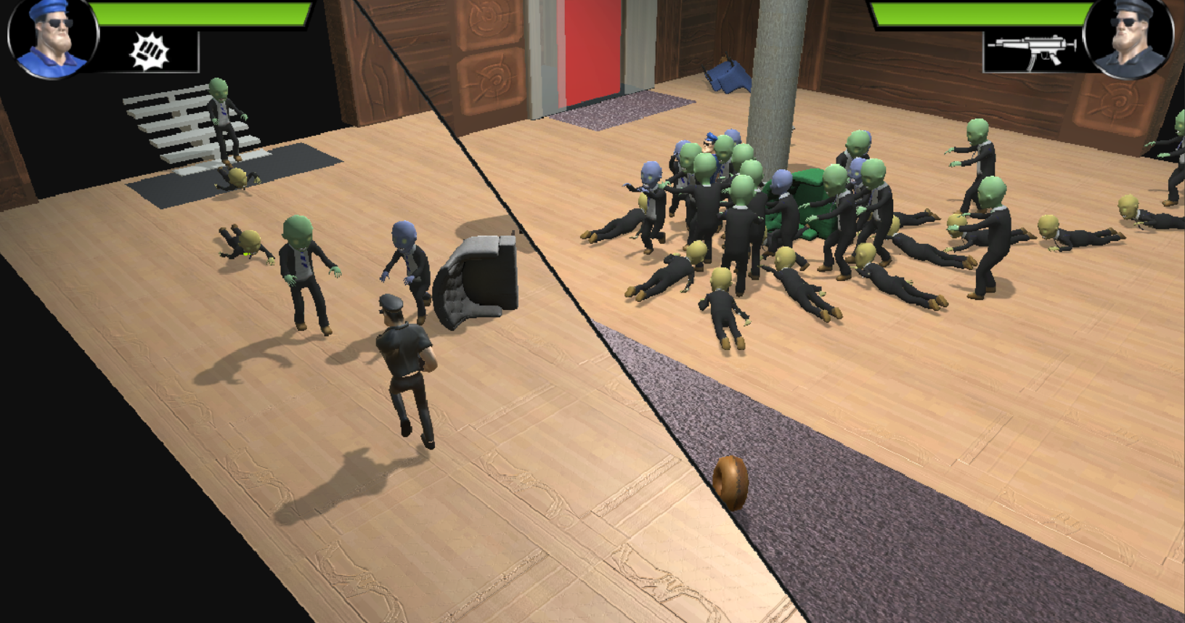

Slide 6
Who doesn't
like chocolate?

Slide 7
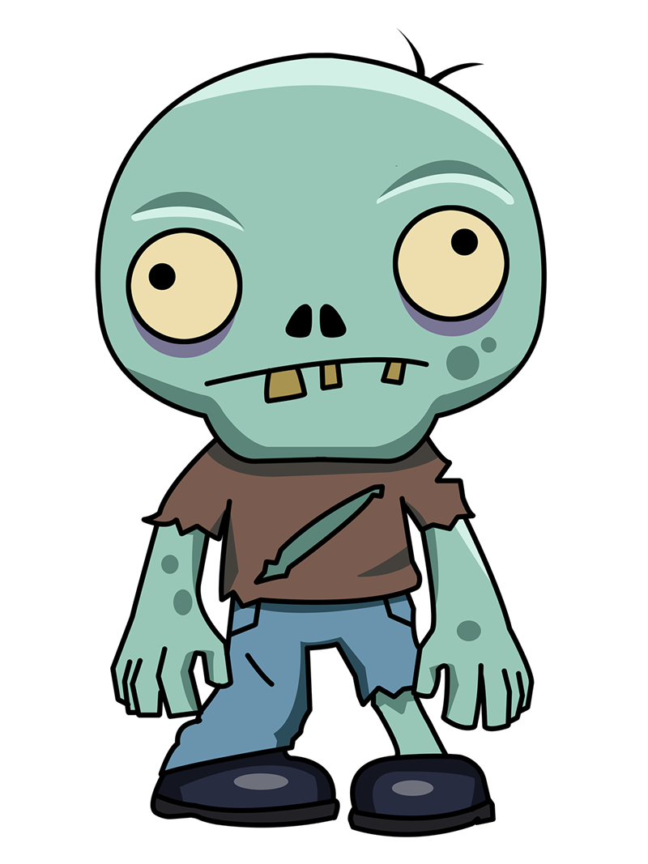

+

Slide 8
Brief
A new chocolate just turned everyone into zombies and the city is upside down.

Slide 9
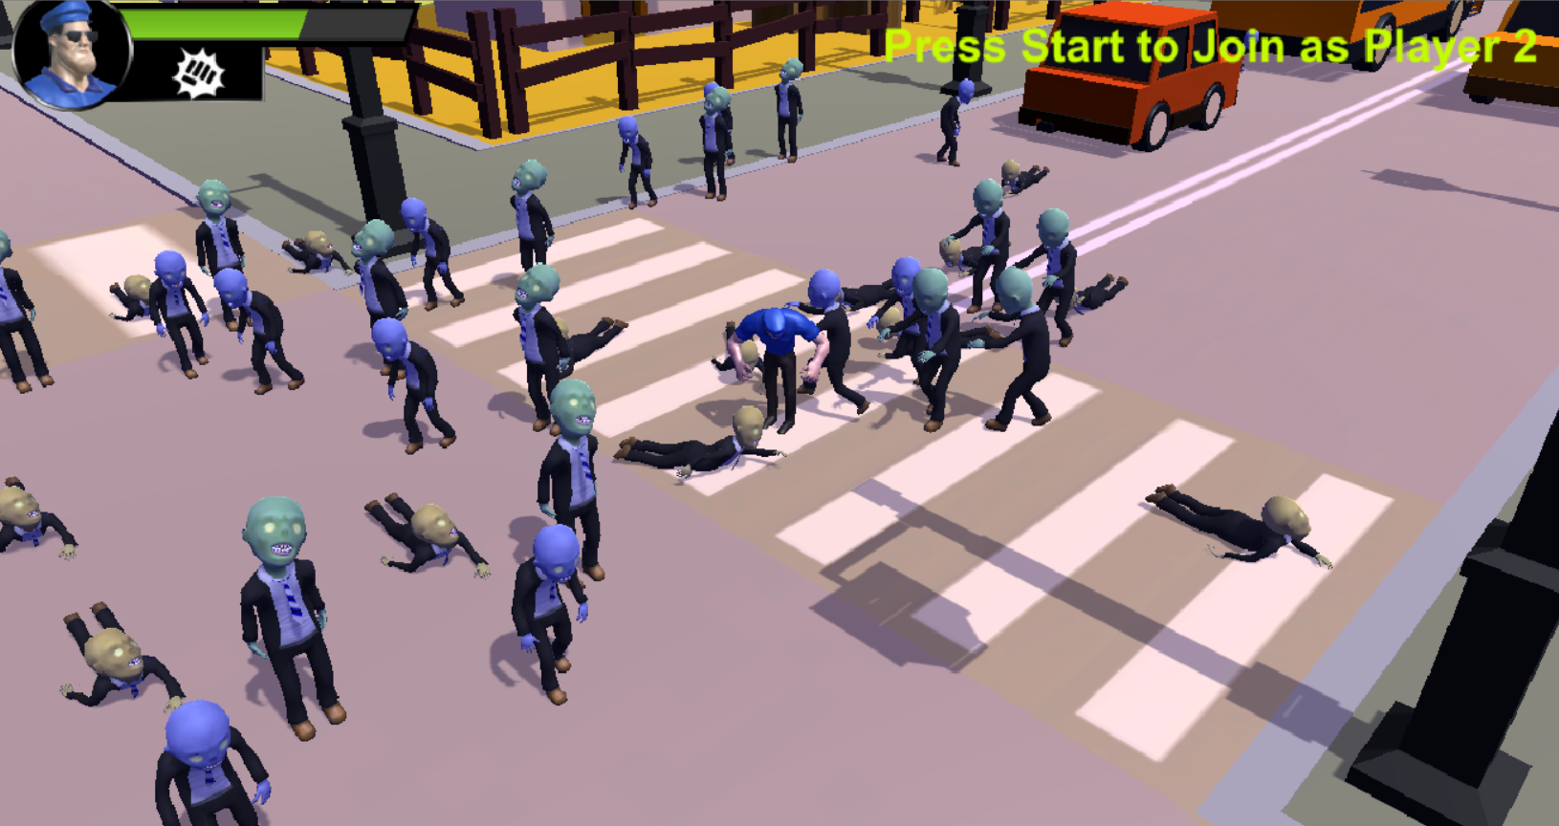

Slide 10
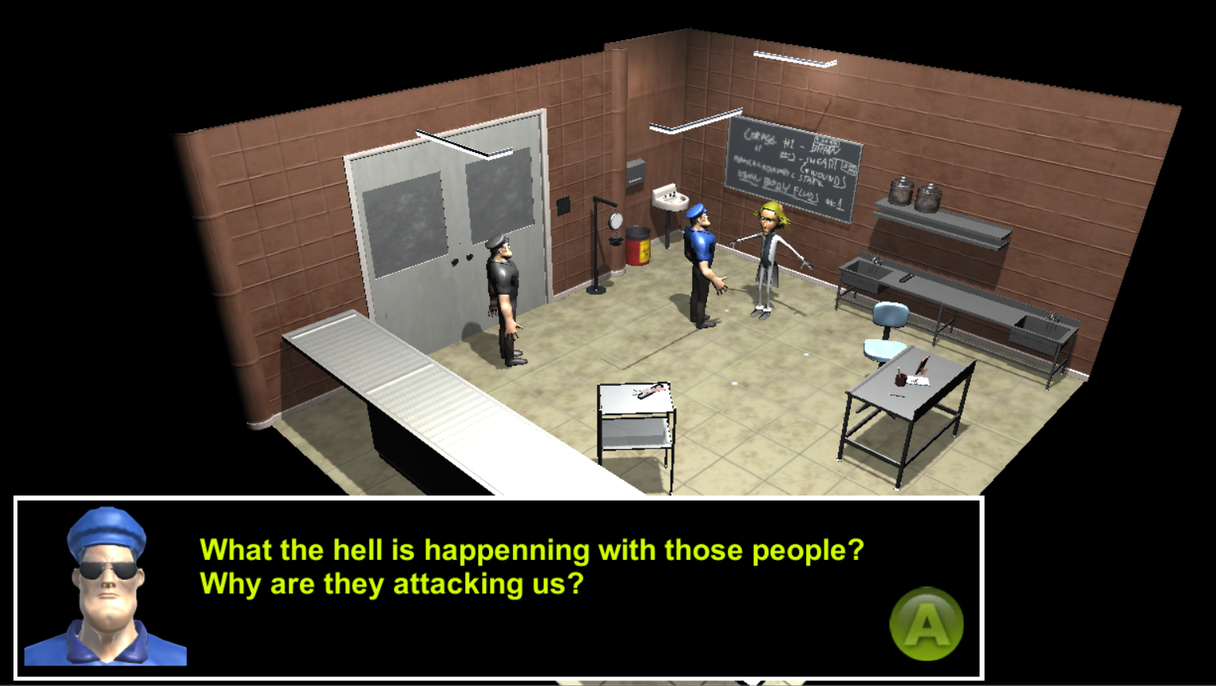

Slide 11
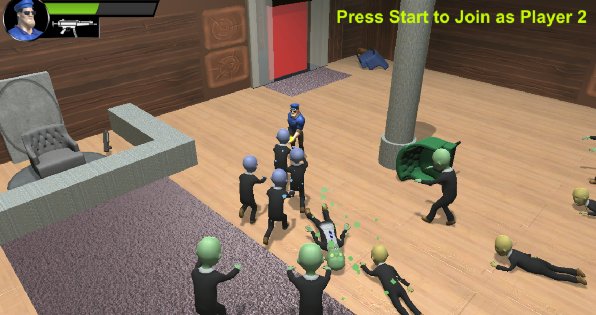

Slide 12
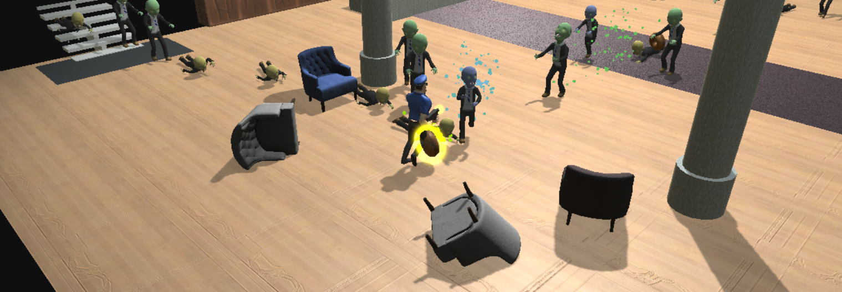

Slide 13
Game
Zombie Beat’ em Up
Cartoonish Looking
Multi-platform (PC/Xbox)
Local Multiplayer
Premium

Slide 14
Inspiration

Slide 15
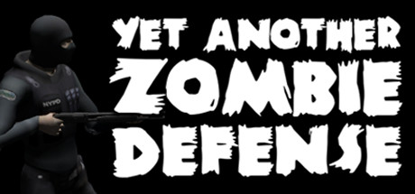
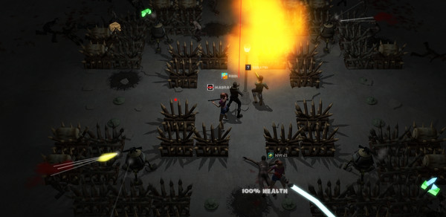
662k units sold

Slide 16
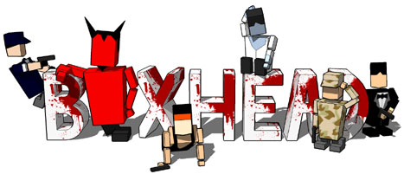

Slide 17
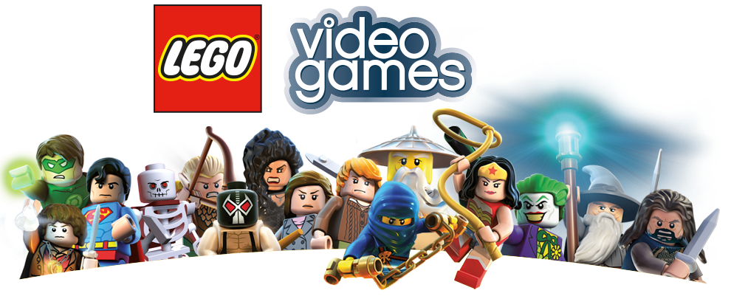
10mi units sold

Slide 18
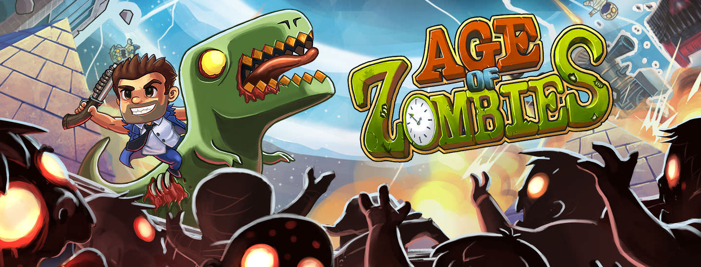

Slide 19
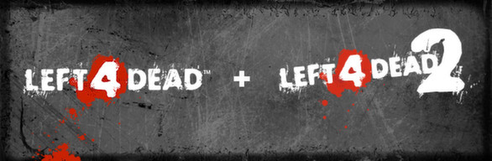
4.8mi + 16.6mi units sold

